Slide 2
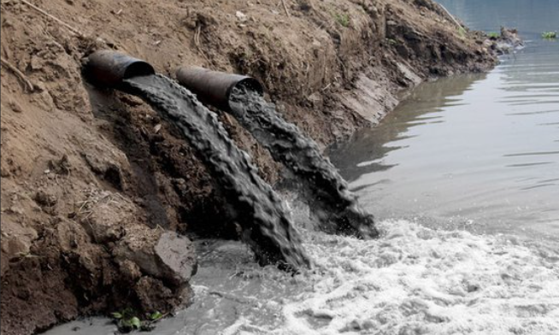
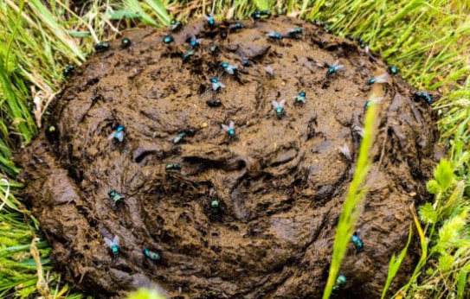
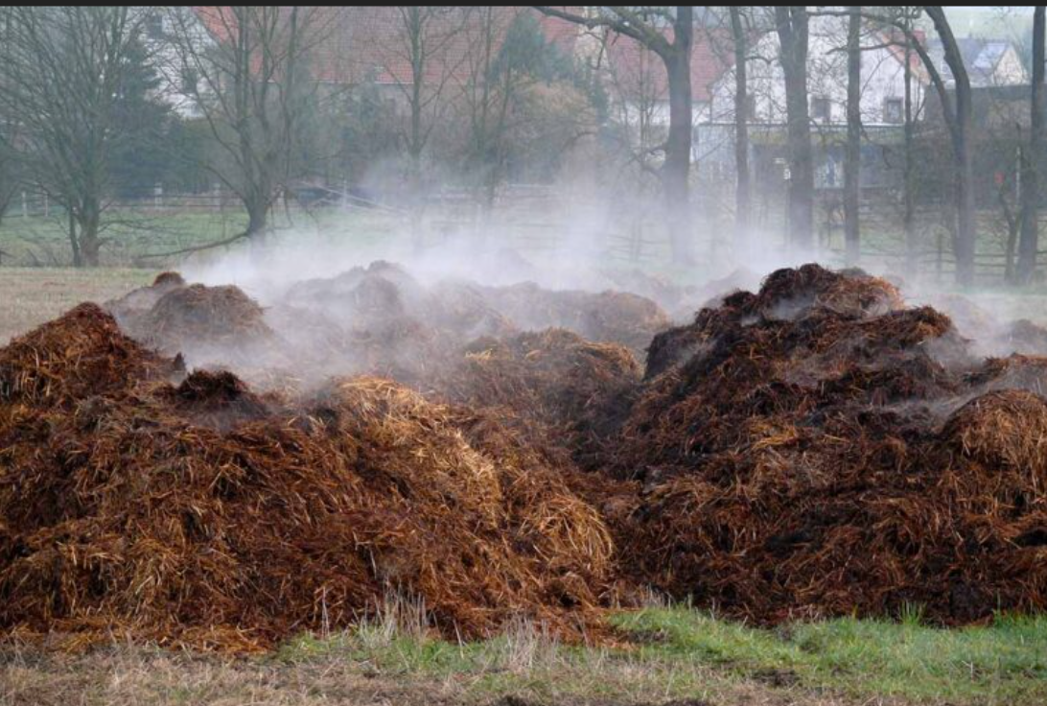
Why is proper manure management important?
Handling problem
Storage and transportation issues
Additional cost for disposal
Smell, biosecurity issues
Major environmental impacts
Valuable nutrients runoff (NPK)
Water contamination
Greenhouse gas emissions
Authority Enforcement
Awareness and proper handling knowledge
Diseases spreading from one farm to another
Uncontrollable spread of AI due to insufficient manure treatment

Slide 3
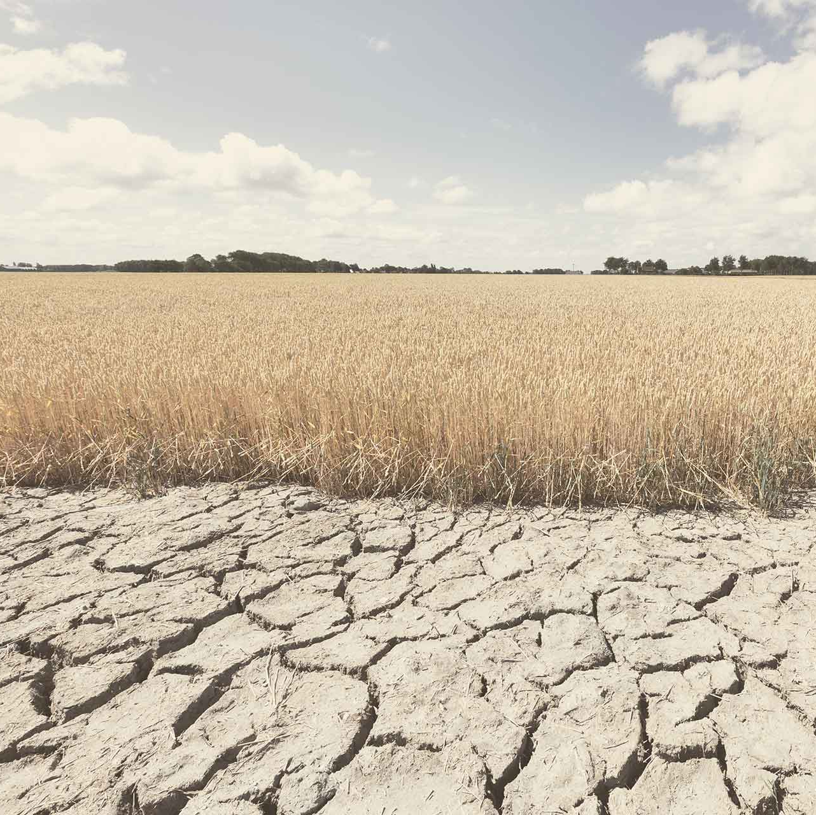
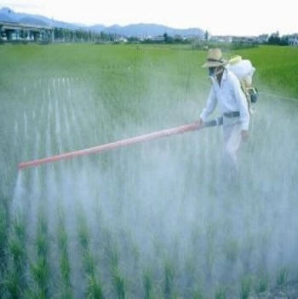
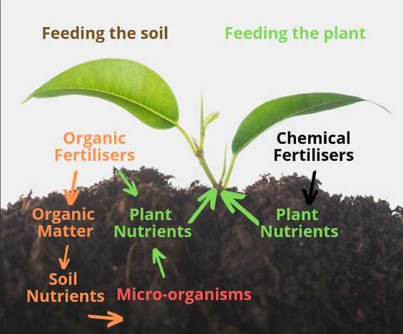
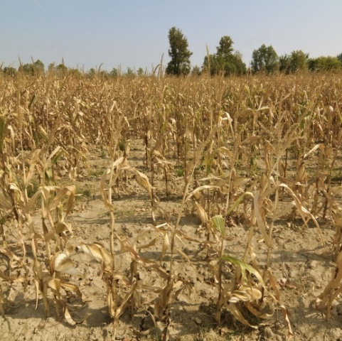
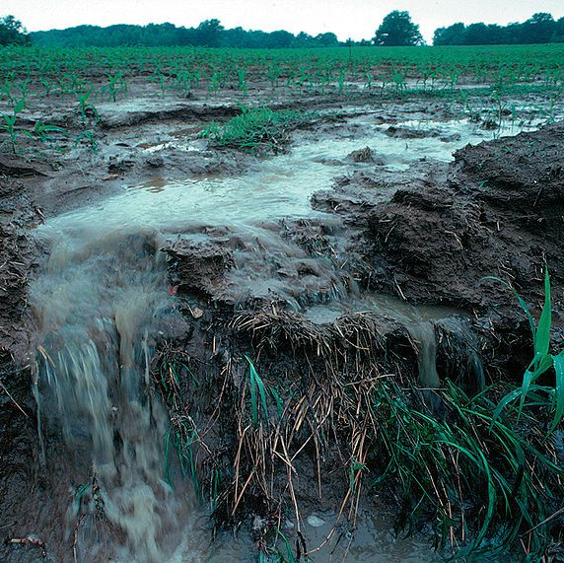
Long-term effects of intensive agriculture
The high use of synthetic fertilizers leads to nitrogen and phosphorous runoff, contributing to water pollution and eutrophication in the ecosystem…
Biodiversity loss
Overuse of pesticides
Soil degradation
Water scarcity

Slide 4
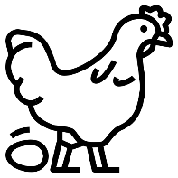
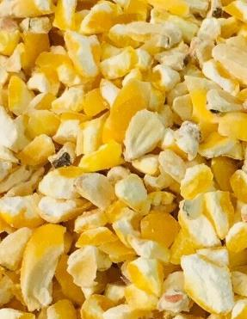
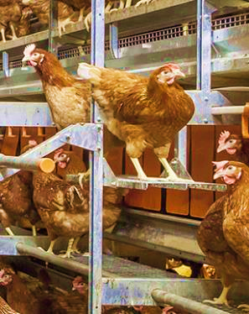
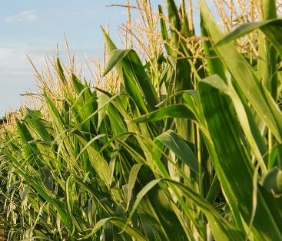
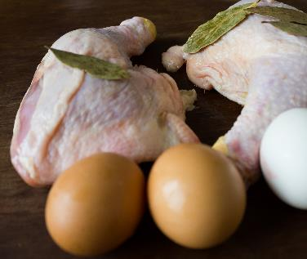
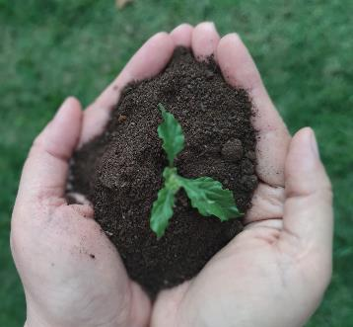
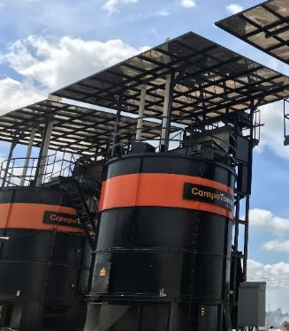
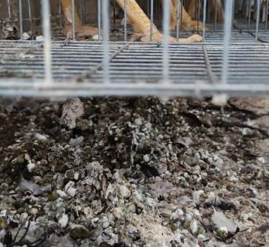
Circular Economy & Sustainable Farming
Farm
Bio-waste
Composting
Compost
Crop production
Protein Production
Feed
Circle of Life

Slide 5
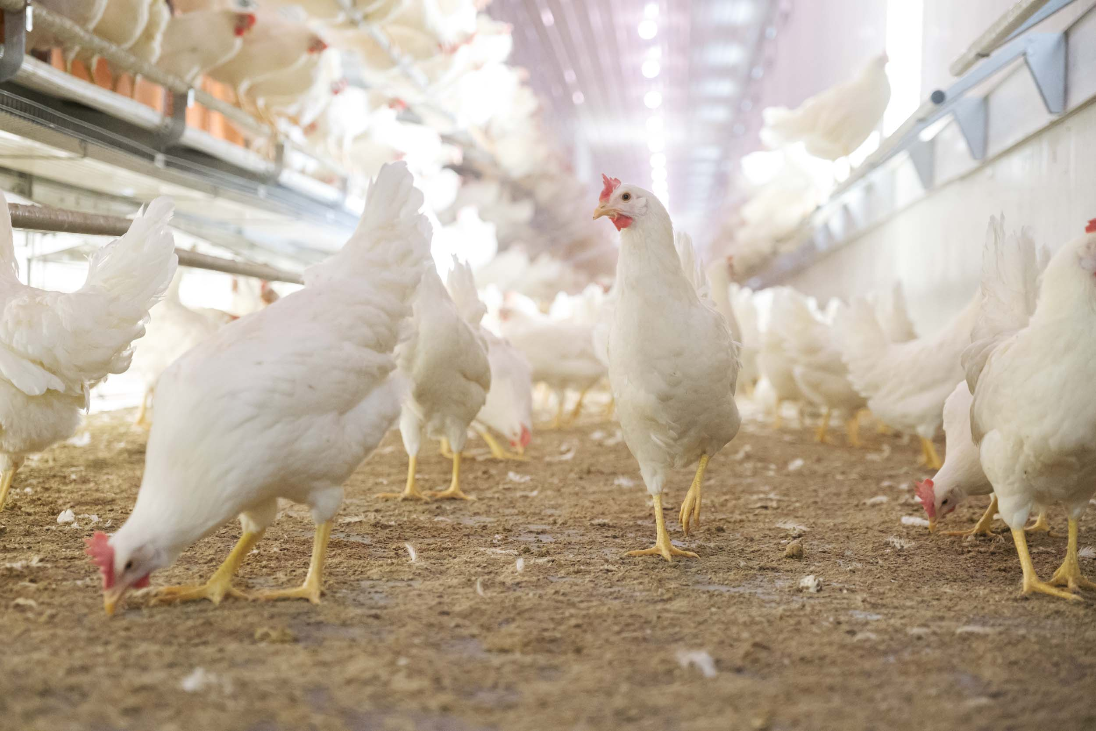
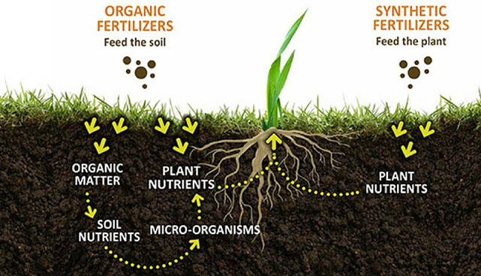
MANURE IS not JUST waste.
It’s a source of SOIL AMENDMENT

Slide 6
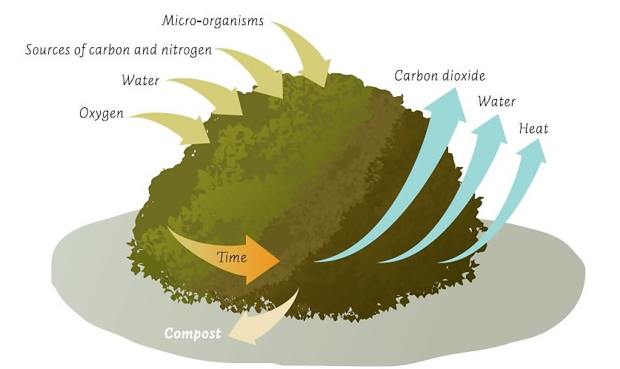
What is composting?
Composting is a biological decomposition of organic materials by aerobic bacteria under oxygen-rich conditions.
Important factors for effecient composting:
Optimum Moisture content (or Dry matter content): Input MC 55 – 65 % (DMC 35 – 45 %)
Aerobic fermentation: Supply of oxygen
Temperature (core mass): 60 – 70 °C

Slide 7
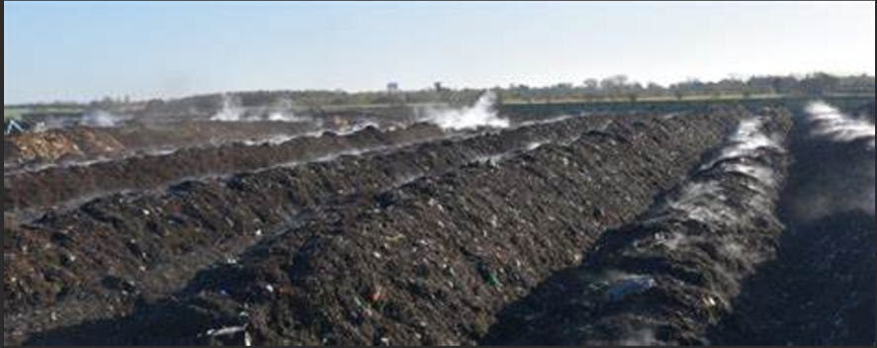
Types of composting
Traditional Windrows
Open Manure piles arranged in rows
Requires agitation frequently using a front end loader.
Low initial investment
Large footprint required
Long processing time (weather dependent)
Odours are difficult to manage.
Fly infestations will occur

Slide 8
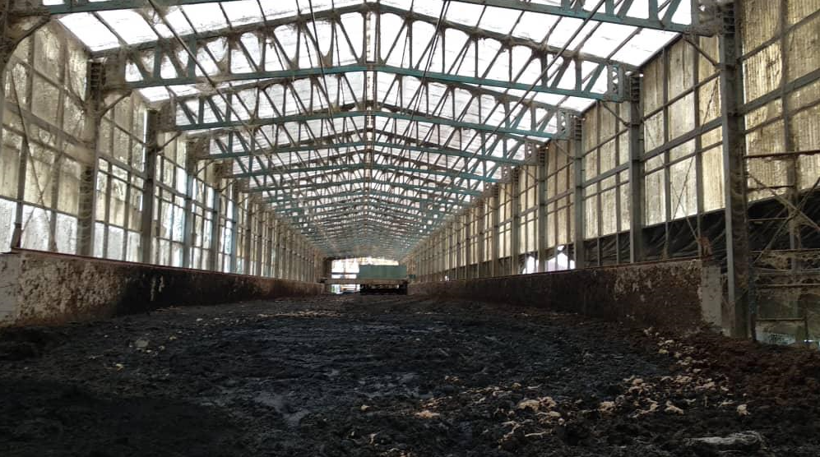
Types of composting
Horizontal Composters
Mostly Open Manure piles in rows or semi closed.
Mechanical agitators required to continously agitate.
Moisture adjustments are required. Saw dust or other materials.
Medium investement since concrete contruction, building and agitators are required.
Long processing time (weather dependent)
Odours are difficult to manage.
Fly infestations will occur

Slide 9
Types of composting
Invessel type Composters
Enclosed vertical system
Aggitators and blowers continously running
Mositure adjustments are not required. Everyday add manure and withdraw compost.
High initial cost.
Short processing time (not weather dependent)
Odours are easy to manage.
Fly infestations will not occur
Bacterial heat production sustained by tank insulation

Slide 10
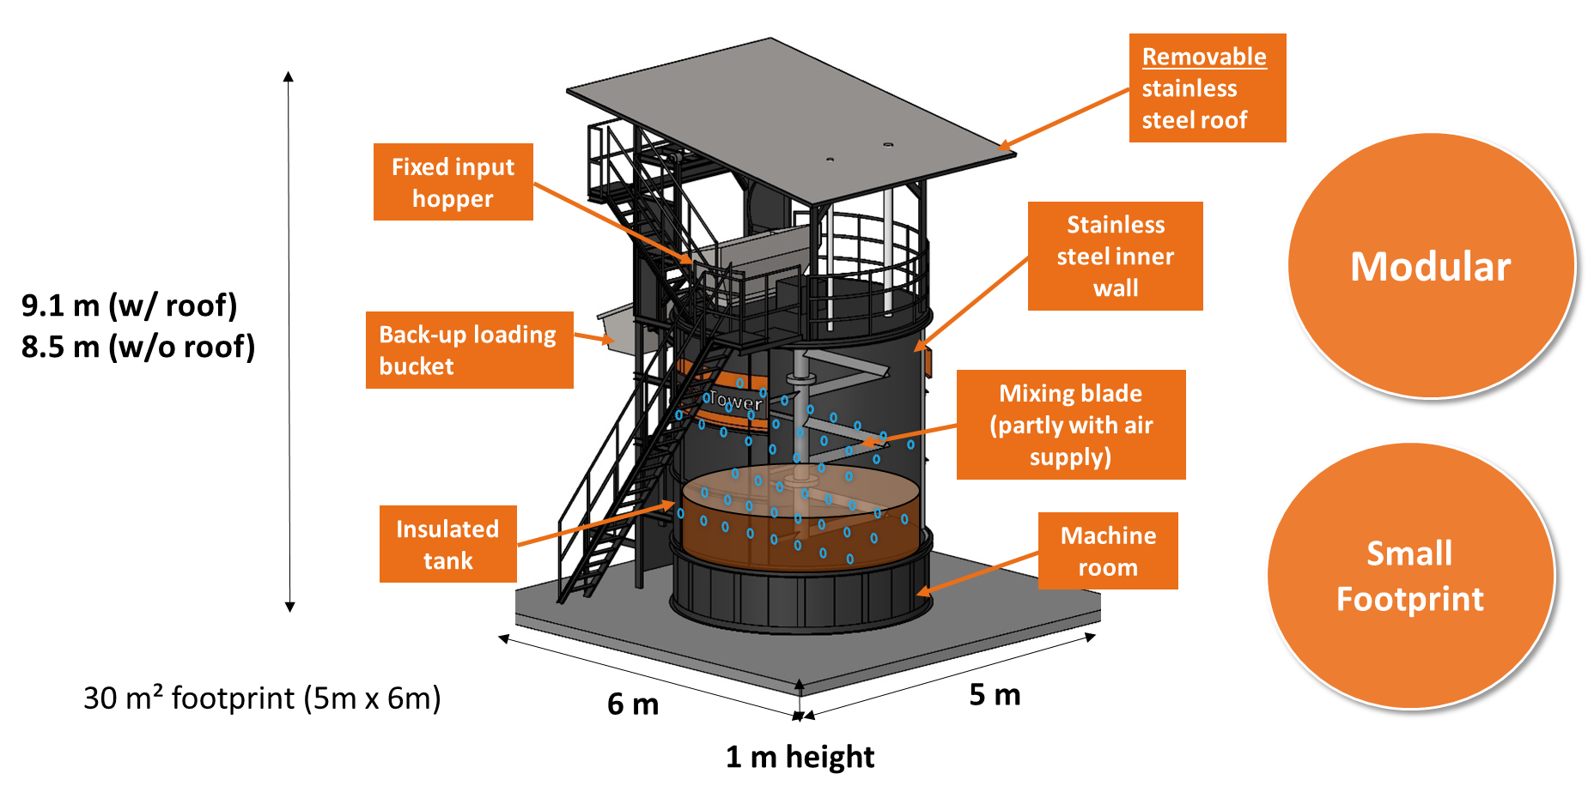

Slide 11
Thermal Inactivatio of Pathogens
Maintaining a temperature of 60℃ for more than an hour can kill disease-causing pathogens including salmonella and E-coli.
Final products are pathogen-free and safe to use
Pathogen | Animal | Inactivation Temp. (°C) | Time (min)
E. coli |  | 55°C 60°C | 60 20
Salmonella |  | 55°C 60°C | 60 20
Listeria |  | 55°C 60°C | 12 3
African Swine Fever (ASF) |  | 60°C | 20 - 30
Avian Influenza |  | 60°C | 30
Swine Vesicular Disease (SVD) |  | 60°C | 15

Slide 12
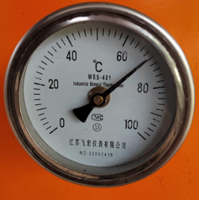
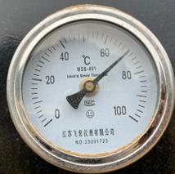
Optimal temperature for composting
High Temperature (60-70°C)
Water evaporation
Pathogen elimination

Slide 13
Operation Video

Slide 14
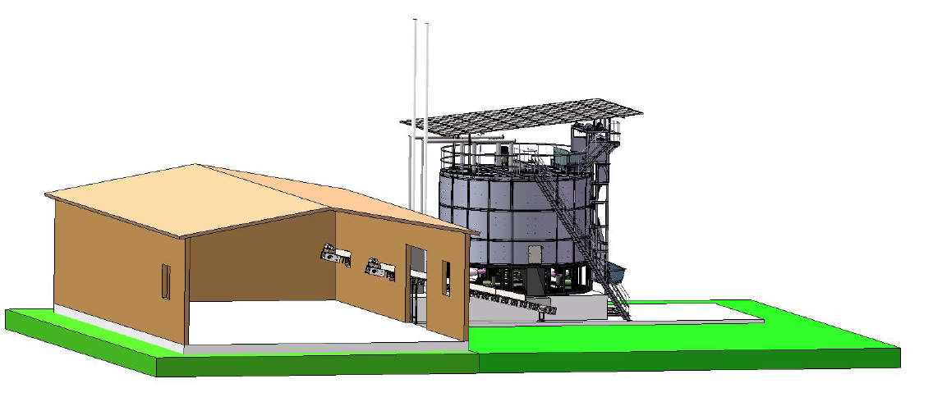
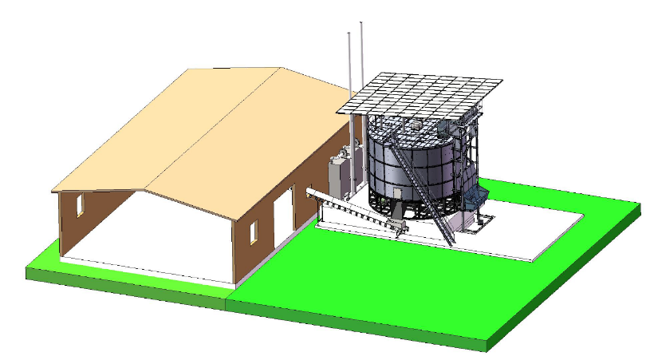
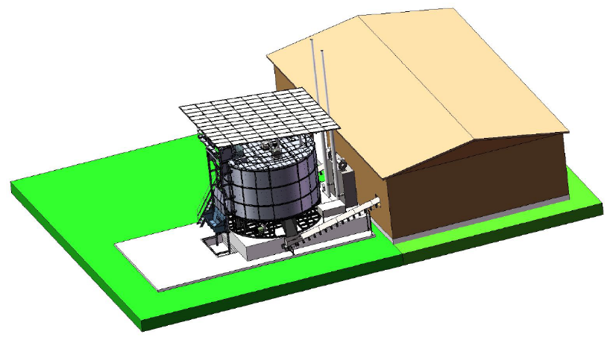
Layout suggestion with compost storage warehouse

Slide 15
Building Circular Economy
Carbon emission
Carbon emission
Powered
Fertilize
Fed
By-produce
Organic waste
Synthetic fertilizer
Crop production
Protein (Food) production
Composting
Buy in to offset carbon footprint
Carbon offset
Carbon sequestration
Compost
Carbon credit

Slide 16
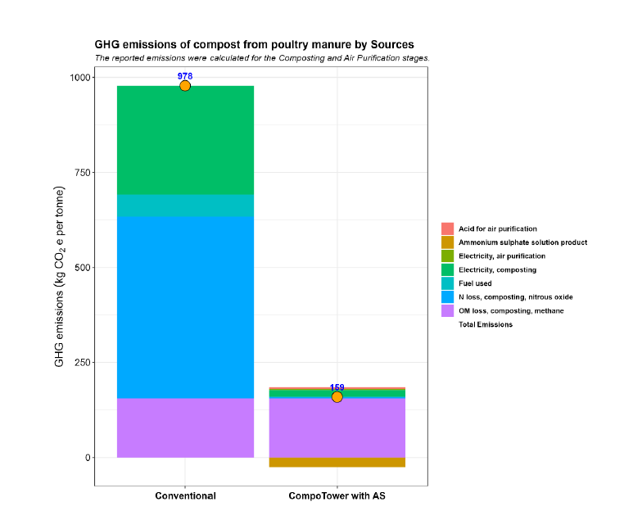
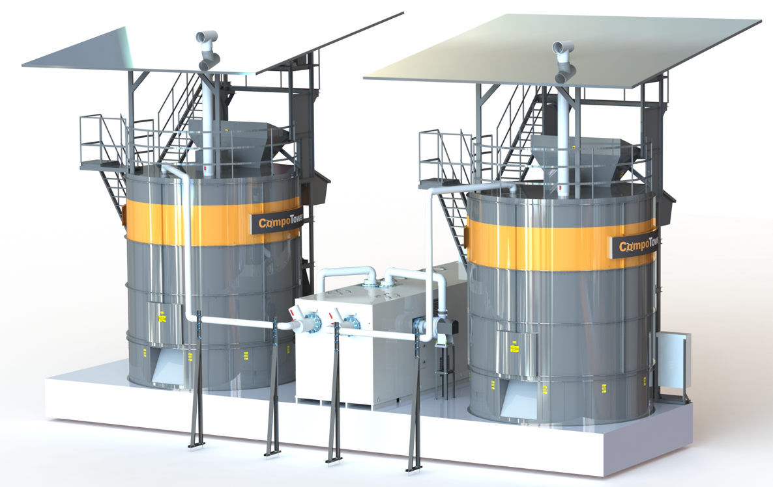
LCA Result

Slide 17
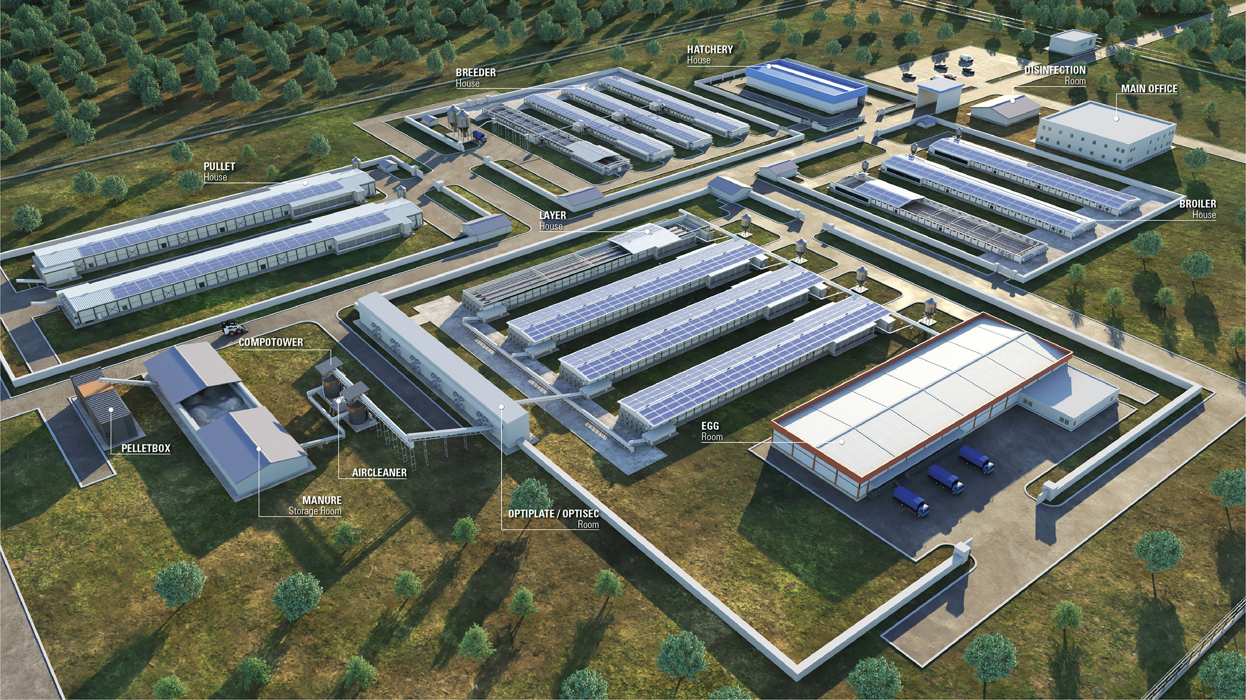
Thank you for
Your attention!

